Slide 1
LTE evolution
Asbjörn Grövlen
Ericsson

Slide 2
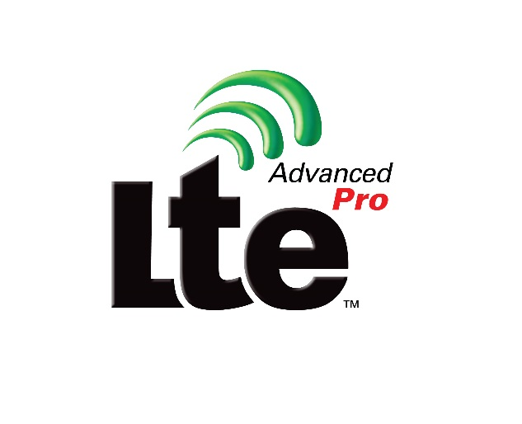
Overview
LTE is submitted as part of the SRIT to IMT-2020
What has happened in LTE since the IMT-Advanced submission?
Lots!

Slide 3
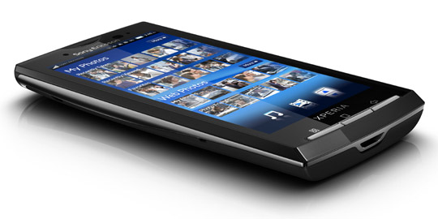
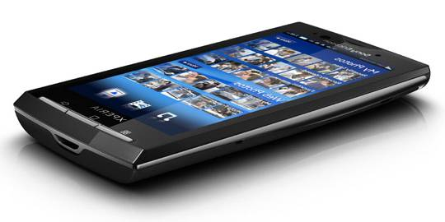
Coordinated Multi-Point Operation
Rel-11→
coordination
coordination
coordination
Introduced coordination across antenna points
Reducing inter-cell interference, improving coverage
Many coordination schemes require fast backhaul
coordination
Intra-site coordination only (Rel-11)
Inter-site coordination (Rel-12)
different resources scheduled
Simultaneous transmission
Dynamic switching
Null forming
Coordination
Coordination
Coordination
Dynamic Point Blanking
Coordinated Beamforming
Joint transmission
Dynamic Point Selection
Coordinated Link Adaptation

Slide 4
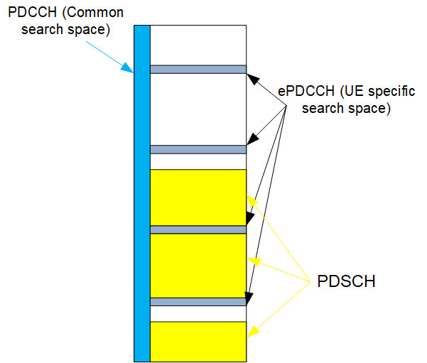
Enhanced downlink control channel
Rel-11→
PDCCH is
always full bandwidth
using common reference signal (CRS)
EPDCCH introduced to support
increased control channel capacity
frequency-domain ICIC
improved spatial reuse of control channel resource
beamforming and/or diversity
The EPDCCH can
be transmitted multiplexed with PDSCH
coexist with legacy UEs on the same carrier
DMRS are used for demodulation

Slide 5
Dual connectivity
Rel-12→
Control and user plane separation
DL (Rel-12)
UL (Rel-13)
Benefits
Increased mobility robustness
Minimize UE context transfer
Minimize re-establishment failures
Split bearer
Data is split on the PDCP layer
Transparent to higher layer protocols
Service specific offloading

Slide 6
Small cells
Rel-11→
Dynamic TDD (eIMTA)
Certain subframes within the radio frame can be dynamically switch between UL and DL
256QAM
1024 QAM also supported in DL
Allow small cells to be turned on/off with low latency
Discovery signal
Radio interface based inter-cell synchronization

Slide 7
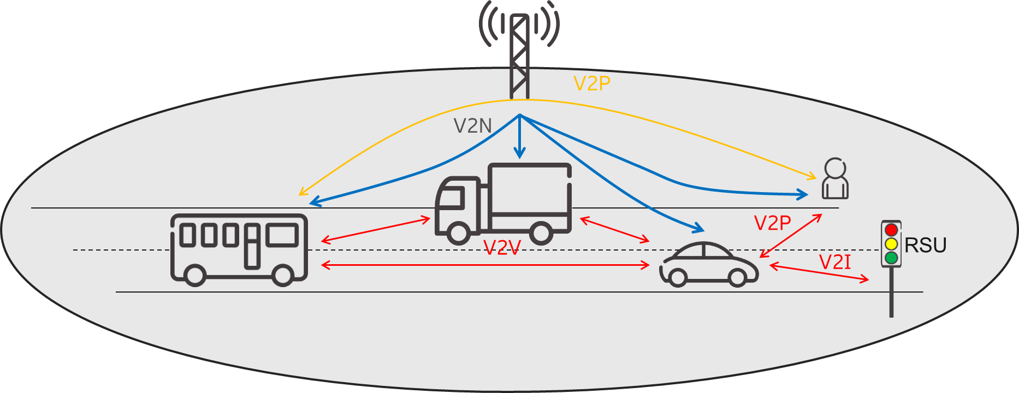



Proximity services (ProSe) and vehicle-to-everything (V2X)
Rel-12→
The introduction of the sidelink interface enables direct UE-to-UE communications
The cellular interface was enhanced to handle efficiently unicast and broadcast traffic
Use cases
Mission critical push-to-talk for first responders (ProSe, Rels. 12-13)
Discovery (ProSe, Rels. 12-13)
Vehicular day-1 safety services such as CAM and DENM (V2X, Rel. 14)
Truck platooning, advanced driving, vehicle sensor sharing (V2X, Rel. 15)
Features
UE-autonomous resource allocation and NW-managed resource allocation for sidelink
Distributed synchronization for operation outside network coverage
New physical layer format for high mobility scenarios (V2X)
Aggregation of multiple sidelink carriers
New cellular multicast periodicities for reduced latency

Slide 8

Licensed-Assisted Access
Rel-13→
Rel-13 Licensed assisted access
Enable gigabit throughput LTE via carrier aggregation framework
Downlink only access to 5 GHz unlicensed bands
Rel-14 Enhanced LAA
Introduce scheduled uplink access to unlicensed bands
Rel-15 Further enhanced LAA
Enhance uplink access throughput and latency with configured grants (aka “autonomous UL”)
Primary Carrier Licensed Spectrum
Secondary Carrier Unlicensed Spectrum
UL
DL

Slide 9
Elevation Beamforming/ Full-Dimension MIMO
Rel-13→
With the introduction of advance antenna systems with more antenna elements, exploiting all three dimensions for MIMO becomes possible
A 3D channel model was developed
Feature components
Increased number CSI-RS ports to 12 and 16
Beam selection
SRS enhancements for low delay spread channels
DMRS enhancements to increase the number of co-scheduled UEs
3GPP 3D UMi
3GPP 3D UMa
- UE height: 1.5-22.5m
- eNodeB height: 10m
- ISD 200m
- UE height: 1.5-22.5m
- eNodeB height: 25m
- ISD 500m

Slide 10
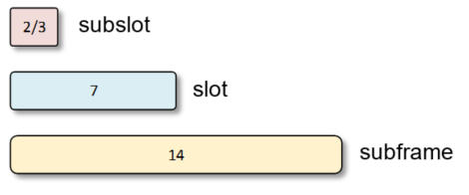
Shortened TTI and processing time
Rel-15
Shortened TTI and processing time for LTE introduces the possibility for subslot- (2 or 3 symbols long) and slot-based transmission, each associated with a short processing time.
A shortened processing time of n+3 (compared to n+4) has also been introduced for subframe-based transmissions
DL and UL control channels have been redesigned (SPDCCH and SPUCCH for UL and DL respectively) ensuring backwards compatibility with existing LTE operation
Higher layer improvements to latency have also been introduced

Slide 11
Summary
Continuous enhancements have improved LTE meeting the IMT-2020 requirements of a component RIT

